Slide 1
Originale

Slide 2






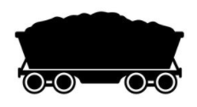


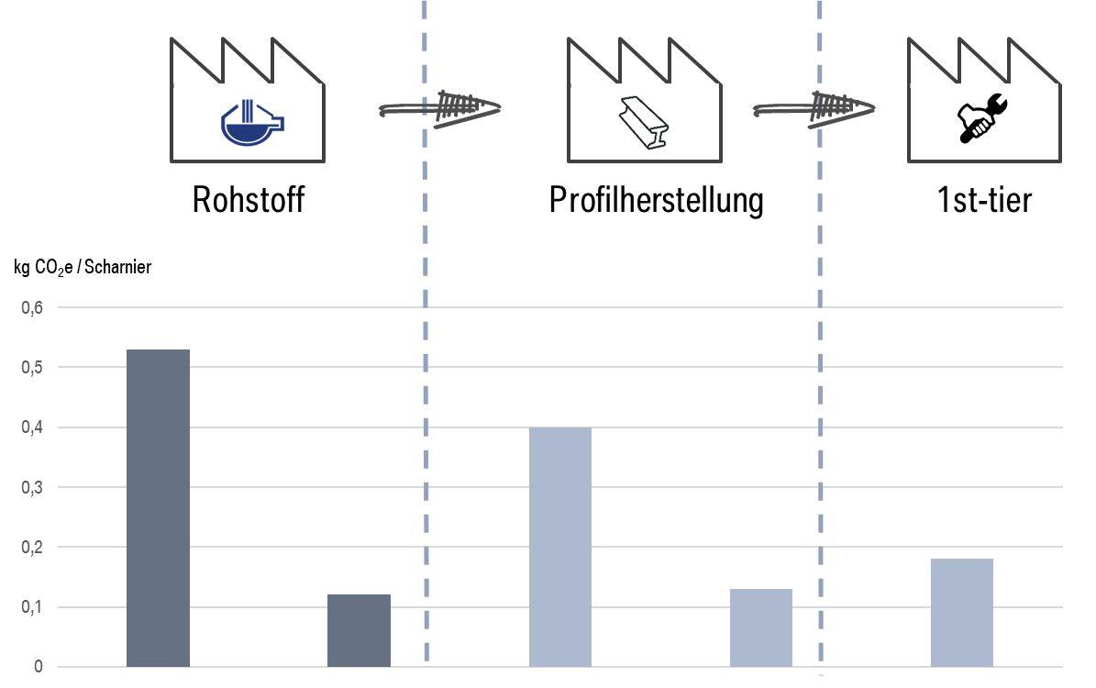


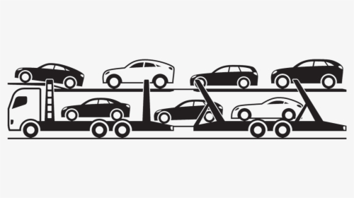
Product Carbon Footprint (PCF) in the automotive supply chain. Scope of Catena-X Use Case.
Supply Chain
OEM
(Raw) Materials
Part / component manufacturing
Vehicle manufacturing and distribution
...
Supplier C
...
Supplier D
Supplier B
Supplier A
Tier x
Tier x-1
Tier n
Tier 2
Tier 1
Material extraction
Material smelting and processing
Manufacturing processes
Vehicle manufacturing
Vehicle
distribution
Scope of Catena-X Use Case PCF
The goal of Catena-X is to collect PCF data along the production chain. Thus, the system boundaries in Catena-X generally range from cradle-to-gate (from raw material to the own factory gate).

Slide 3
Product Carbon Footprint (PCF) in the automotive supply chain. Scope of Catena-X Use Case.
Supply Chain
OEM
(Raw) Materials
Part / component manufacturing
Vehicle manufacturing and distribution
PCF
...
PCF
PCF
PCF
Supplier C
PCF
PCF
...
PCF
PCF
PCF
DO
Supplier D
Supplier B
Supplier A
< not in scope >
< not in scope >
Tier x
Tier x-1
...
Material extraction
Material smelting and processing
Tier n
Tier 2
Tier 1
Vehicle manufacturing
Vehicle
distribution
Manufacturing processes
direct emissions from sources within own borders
indirect emissions from outside generated and purchased electricity, steam, heat and cold
Resulting PCF ( + + )
all other indirect emissions in the upstream supply chain
In each node of the supply chain, the PCF is calculated from the respective direct and indirect emissions. The PCF value is passed on from the supplier to the customer and is then again incorporated into the customers PCF calculation.

Slide 4


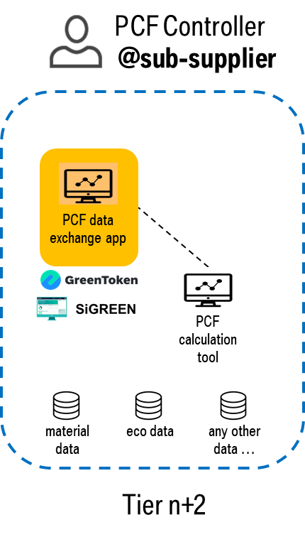




PCF data exchange along the supply chain. PCF Request and PCF Response.
PCF Controller
@customer
PCF Controller
@supplier
send
1) PCF Request
receive
PCF data exchange app
PCF data exchange app
2) Calculate PCF
4) Use PCF
receive
3) PCF Response
send
…
PCF calculation tool
PCF calculation tool
Using CX infrastructure for identity management, authorization, digital asset management, data exchange, …
material data
eco data
any other data …
material data
eco data
any other data …
Request/response process can
cascade down the supply chain
Tier n
Tier n+1

Slide 5
Layout für PCF-KIT (White)

Slide 6
Product Carbon Footprint (PCF) in the automotive supply chain. Scope of Catena-X Use Case.
Supply Chain
OEM
(Raw) Materials
Part / component manufacturing
Vehicle manufacturing and distribution
...
Supplier C
...
Supplier D
Supplier B
Supplier A
Tier x
Tier x-1
Tier n
Tier 2
Tier 1
Material extraction
Material smelting and processing
Manufacturing processes
Vehicle manufacturing
Vehicle
distribution
Scope of Catena-X Use Case PCF
The goal of Catena-X is to collect PCF data along the production chain. Thus, the system boundaries in Catena-X generally range from cradle-to-gate (from raw material to the own factory gate).

Slide 7

Product Carbon Footprint (PCF) in the automotive supply chain. Scope of Catena-X Use Case.
Supply Chain
OEM
(Raw) Materials
Part / component manufacturing
Vehicle manufacturing and distribution
PCF
...
PCF
PCF
PCF
Supplier C
PCF
...
PCF
PCF
PCF
PCF
Supplier D
Supplier B
Supplier A
< not in scope >
< not in scope >
Tier x
Tier x-1
...
Material extraction
Material smelting and processing
Tier n
Tier 2
Tier 1
Vehicle manufacturing
Vehicle
distribution
Manufacturing processes
direct emissions from sources within own borders
Resulting PCF ( + + )
indirect emissions from outside generated and purchased electricity, steam, heat and cold
all other indirect emissions in the upstream supply chain
In each node of the supply chain, the PCF is calculated from the respective direct and indirect emissions. The PCF value is passed on from the supplier to the customer and is then again incorporated into the customers PCF calculation.

Slide 8
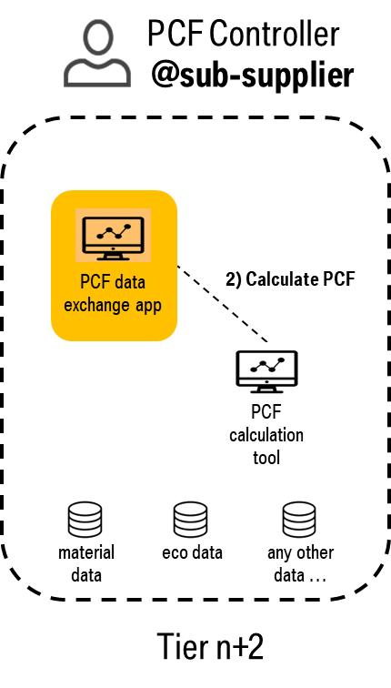
PCF data exchange along the supply chain. PCF Request and PCF Response.
PCF Controller
@customer
PCF Controller
@supplier
Catena-X
Automotive Network
send
1) PCF Request
receive
PCF data exchange app
PCF data exchange app
2) Calculate PCF
4) Use PCF
receive
3) PCF Response
send
…
PCF calculation tool
PCF calculation tool
Using CX infrastructure for identity management, authorization, digital asset management, data exchange, …
material data
eco data
any other data …
material data
eco data
any other data …
Request/response process can
cascade down the supply chain
Tier n
Tier n+1

Slide 9
Layout für PCF-KIT (Black)

Slide 10
Product Carbon Footprint (PCF) in the automotive supply chain. Scope of Catena-X Use Case.
Supply Chain
OEM
(Raw) Materials
Part / component manufacturing
Vehicle manufacturing and distribution
...
Supplier C
...
Supplier D
Supplier B
Supplier A
Tier x
Tier x-1
Tier n
Tier 2
Tier 1
Material extraction
Material smelting and processing
Manufacturing processes
Vehicle manufacturing
Vehicle
distribution
Scope of Catena-X Use Case PCF
The goal of Catena-X is to collect PCF data along the production chain. Thus, the system boundaries in Catena-X generally range from cradle-to-gate (from raw material to the own factory gate).

Slide 11
Product Carbon Footprint (PCF) in the automotive supply chain. Scope of Catena-X Use Case.
Supply Chain
OEM
(Raw) Materials
Part / component manufacturing
Vehicle manufacturing and distribution
PCF
...
PCF
PCF
PCF
Supplier C
PCF
...
PCF
PCF
PCF
PCF
Supplier D
Supplier B
Supplier A
< not in scope >
< not in scope >
Tier x
Tier x-1
...
Material extraction
Material smelting and processing
Tier n
Tier 2
Tier 1
Vehicle manufacturing
Vehicle
distribution
Manufacturing processes
direct emissions from sources within own borders
Resulting PCF ( + + )
indirect emissions from outside generated and purchased electricity, steam, heat and cold
all other indirect emissions in the upstream supply chain
In each node of the supply chain, the PCF is calculated from the respective direct and indirect emissions. The PCF value is passed on from the supplier to the customer and is then again incorporated into the customers PCF calculation.

Slide 12
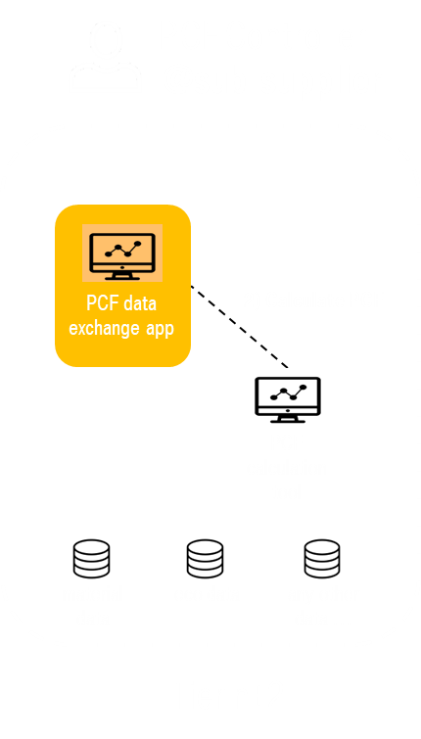
PCF data exchange along the supply chain. PCF Request and PCF Response.
PCF Controller
@customer
PCF Controller
@supplier
send
1) PCF Request
receive
PCF data exchange app
PCF data exchange app
2) Calculate PCF
4) Use PCF
receive
3) PCF Response
send
…
PCF calculation tool
PCF calculation tool
Using CX infrastructure for identity management, authorization, digital asset management, data exchange, …
material data
eco data
any other data …
material data
eco data
any other data …
Request/response process can
cascade down the supply chain
Tier n
Tier n+1

Slide 13
PCF Controller
@sub-supplier
PCF Controller
@sub-supplier
PCF data exchange app
2) Calculate PCF
PCF data exchange app
2) Calculate PCF
PCF calculation tool
PCF calculation tool
material data
eco data
any other data …
material data
eco data
any other data …
Tier n+2
Tier n+2

